Slide 1

A gamified introduction to Python Programming Lecture 12 Memory management in lists and Numpy
Matthieu DE MARI – Singapore University of Technology and Design

Slide 2

Outline (Chapter 12)
A quick word on memory management and lists: aliasing, shallow and deep copies.
What is a library?
What is the Numpy library and its basic concepts (e.g. arrays, math functions, etc.)?

Slide 3
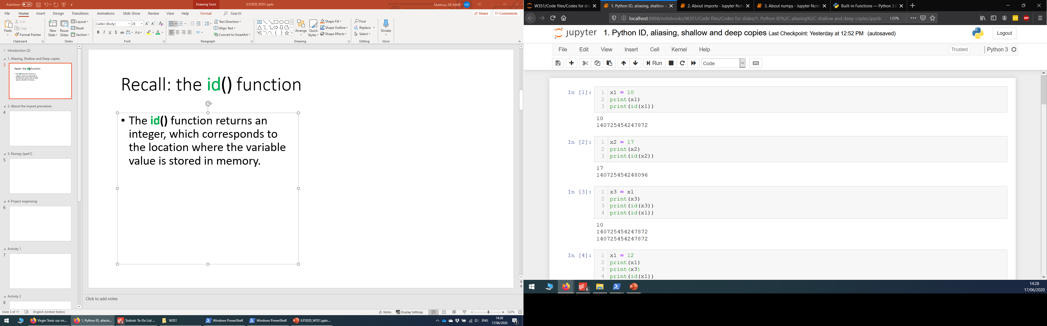
Memory of a computer
Identifier | Memory
 | Address | Value
x1 | 140725454247872 | 10
 | … | …
The memory of a computer consists of several “boxes”, which contain values for variables. Each “box” is identified by an address/ID.
When a variable is created:
A “box” is assigned for the variable and its value is stored in the “box”.
The variable name simply refers to the address/ID of the “box”.

Slide 4
Recall: the id() function
Definition (Aliasing):
Python saves memory space by having two variables point to the same memory ID/location. This is called aliasing.
Two variables with different names but identical values might end up being stored in the same address, to save memory space.
This can be confirmed by checking the id() of both variables.

Slide 5
Recall: the id() function
Identifier | Memory
 | Address | Value
x1, x3 | 140725454247872 | 10
 | … | …
Definition (Aliasing):
Python saves memory space by having two variables point to the same memory ID/location. This is called aliasing.
Two variables with different names but identical values might end up being stored in the same address, to save memory space.
This can be confirmed by checking the id() of both variables.

Slide 6
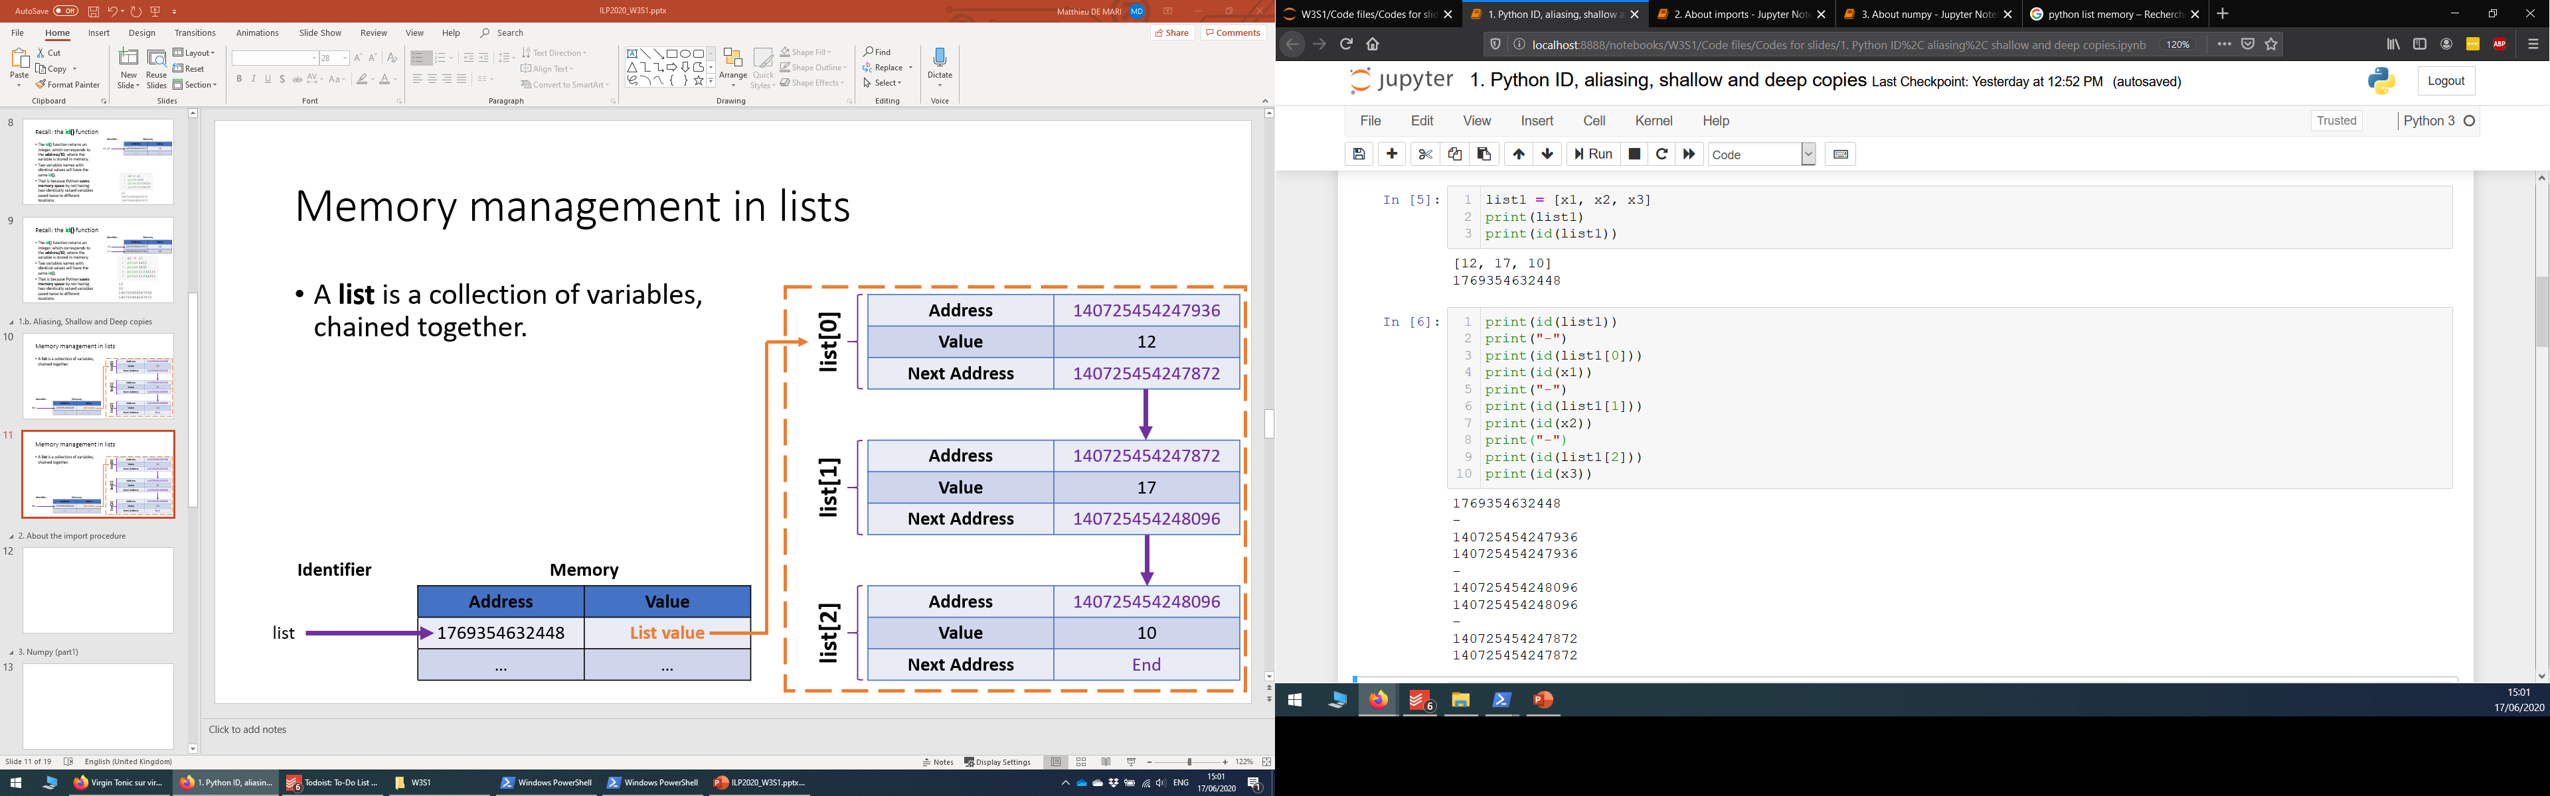
Memory management in lists
A list is a collection of variables.
If variables are assembled in a list, we reuse the existing memory locations (same id).

Slide 7
Memory management in lists
A list is a collection of variables.
The variables in a list are chained together.
(In practice, it is actually more complex than this, but for now, at our current beginner level, this will do!)
Address | 140725454247936
Value | 12
Next Address | 140725454247872
list1[0]
Address | 140725454247872
Value | 17
Next Address | 140725454248096
list1[1]
Identifier | Memory
 | Address | Value
list1 | 1769354632448 | List value
 | … | …
Address | 140725454248096
Value | 10
Next Address | End of list
list1[2]

Slide 8
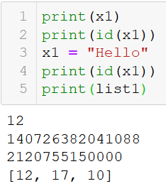
Memory management in lists
When playing with simple (non-compound) types of variables, such as int, float and strings, Python is smart enough to address aliasing.
If x1 is changed, Python will adjust so that the list remains unaffected.
It simply reallocates x1 to another location in memory, so the list remains unaffected.

Slide 9
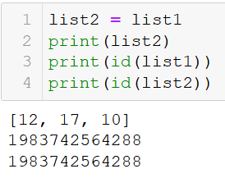
Aliasing in lists: problem
A list is a collection of variables.
The variables in a list are chained together.
Aliasing: We can assign a list to another variable name and reuse the existing memory spaces, not creating new ones.

Slide 10
Aliasing in lists: problem
A list is a collection of variables.
The variables in a list are chained together.
Aliasing: We can assign a list to another variable name and reuse the existing memory spaces, not creating new ones.
Address | 140725454247936
Value | 12
Next Address | 140725454247872
list1[0] list2[0]
Address | 140725454247872
Value | 17
Next Address | 140725454248096
list1[1]
list2[1]
Identifier | Memory
 | Address | Value
list1, list2 | 1769354632448 | List value
 | … | …
Address | 140725454248096
Value | 10
Next Address | End of list
list1[2]
list2[2]

Slide 11
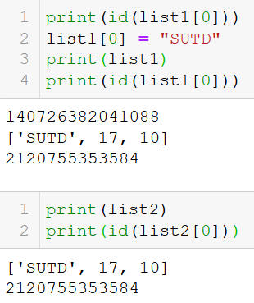
Aliasing in lists: problem
Problem: changing list1[0] changes list1 values, but also changes list2!
When aliasing is used on list variables, Python is not smart enough to address the aliasing to leave the second list unaffected!

Slide 12
Aliasing in lists: problem
Problem: changing list1[0] changes list1 values, but also changes list2!
When aliasing is used on list variables, Python is not smart enough to address the aliasing to leave the second list unaffected!
Address | 140725454247936
Value | 12 → “SUTD”
Next Address | 140725454247872
list1[0] list2[0]
Address | 140725454247872
Value | 17
Next Address | 140725454248096
list1[1]
list2[1]
Identifier | Memory
 | Address | Value
list1, list2 | 1769354632448 | List value
 | … | …
Address | 140725454248096
Value | 10
Next Address | End of list
list1[2]
list2[2]

Slide 13
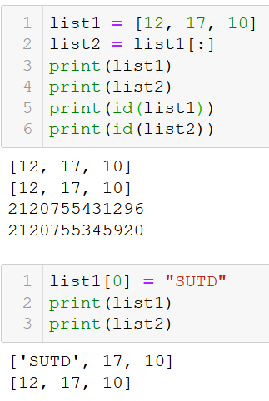
Shallow copy of a list
Definition (shallow copying):
The operation list2 = list1[:] makes list2 a shallow copy of list1. By doing so, list2 will be saved to its own location of memory.
Having done a shallow copy, changing a value in list1, with list1[index] = …, no longer affects the values list2. They have different memory IDs now!
Note: you can also use the copy() method.

Slide 14
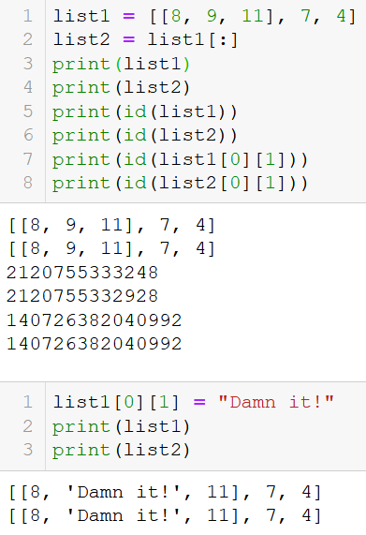
Shallow copy: problem
Note: if an element of a list is a list (case of lists of lists), then the shallow copy will not copy the sublists to different locations of memory.
Problem: changing the element of a sublist then affects both lists, even though these lists are shallow copies of each other…
The problem repeats!

Slide 15
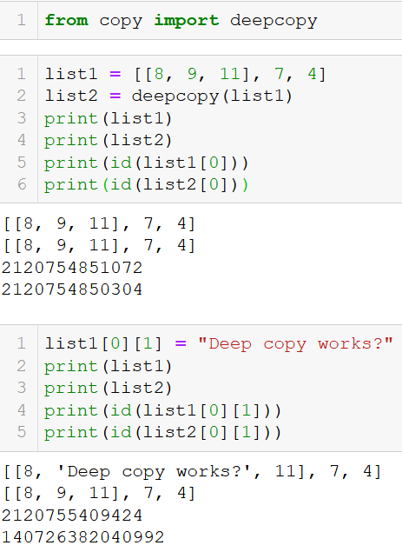
Deep copy
Solution: make a deep copy, using the deepcopy function from the Python built-in copy library.
A deep copy forces Python to make sure all elements and sub-elements are assigned to different locations in memory.
Stronger and safer than a shallow copy!
If in doubt, just deep copy!

Slide 16
Matt’s Great advice
Matt’s Great Advice: Keep the aliasing, shallow and deep copies concepts in mind for now.
If you find that modifying a list object ends up unexpectedly changing another, then you might have an aliasing or shallow copy problem.
When in doubt, make a deep copy.
For now, do not worry about understanding all these memory concepts, these will be covered in another advanced course!

Slide 17



Please download and install the Slido app on all computers you use
What will be printed here?
ⓘ Start presenting to display the poll results on this slide.

Slide 18
Please download and install the Slido app on all computers you use
What needs to be changed to make the printed result [[0, 5, 0], [0, 0, 0], [0, 0, 0]]?
ⓘ Start presenting to display the poll results on this slide.

Slide 19
Please download and install the Slido app on all computers you use
What will be displayed?
ⓘ Start presenting to display the poll results on this slide.

Slide 20
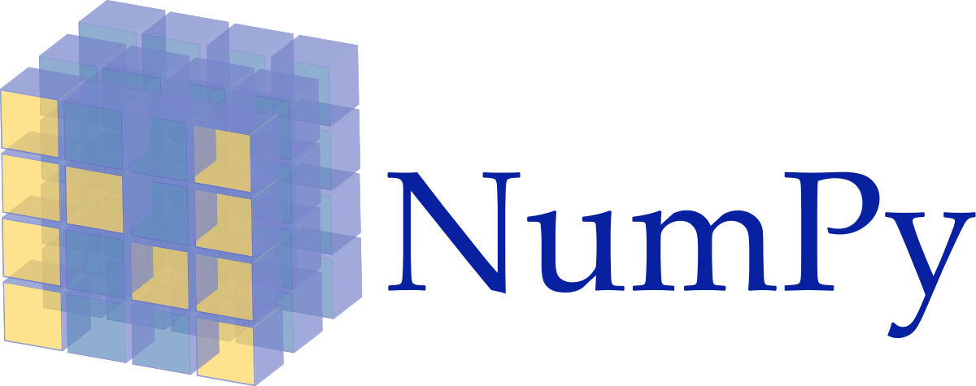
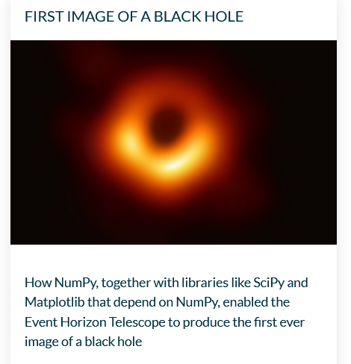
About the numpy library
NumPy (or numpy or Numpy) is one of the most common libraries (if not the most popular one) in Python.
It is used for many applications: computing, modelling, data science, astrophysics, etc.
Linear algebra (one of the main concepts of math with many applications in computing)

Slide 21
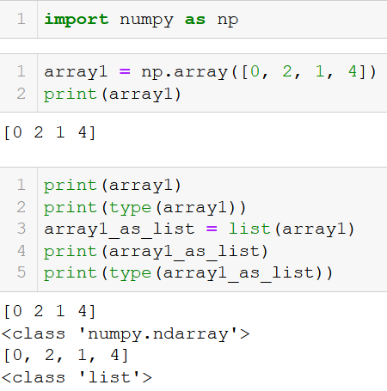
A new type of objects: Numpy Arrays
Numpy arrays are objects from the Numpy library.
Typically used to describe matrices and vectors,
Or tables of data.
They look very similar to lists of lists, which we have used earlier for many applications.
The Numpy library, however, comes with many additional functions and methods.

Slide 22
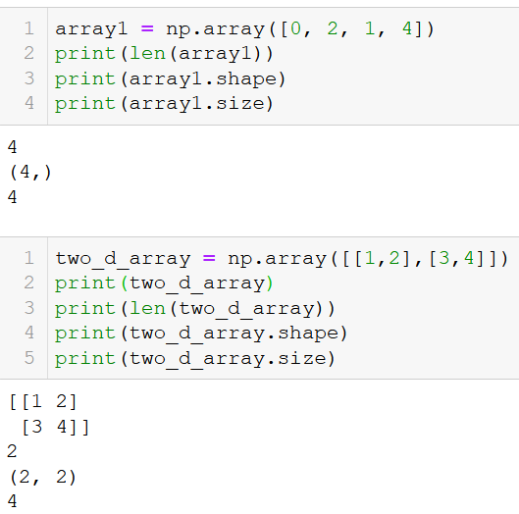
Length, size, shape
As lists, Numpy arrays have a length, which can be checked with len().
The also have a shape and a size attribute, which give additional information, in the case of arrays with more than 1D.
Attribute: “sub-variable” of an object; can be drawn from an object using the . operator (Has to do with object-oriented prog., covered later).

Slide 23
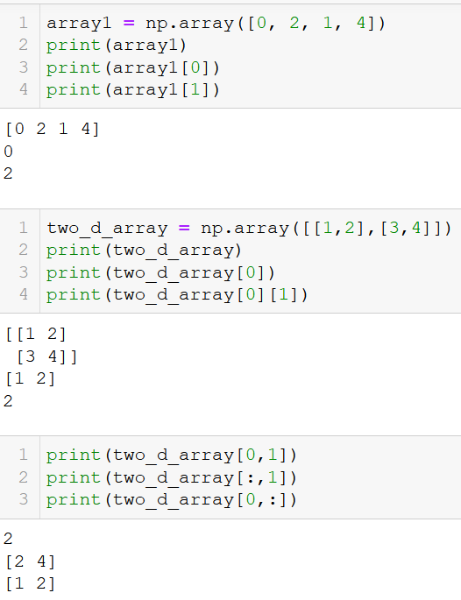
Indexing an array
Just like lists, the Numpy arrays are indexed and their element can be accessed with [].
You can equivalently use the [i,j] and [i][j] notations on arrays.
Replacing an index with a colon symbol :, means “take all”.
For instance, [:, j] means all elements in column j, whereas [i, :] means all elements in row i.

Slide 24
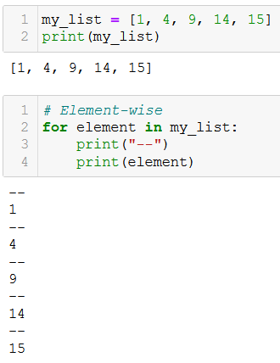
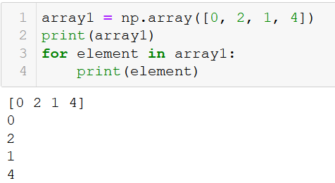
Traversing an array with for
As with lists, we can traverse a Numpy array, in an element-wise manner, using a for loop.

Slide 25
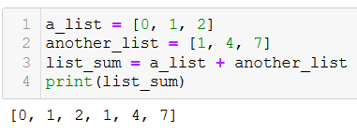
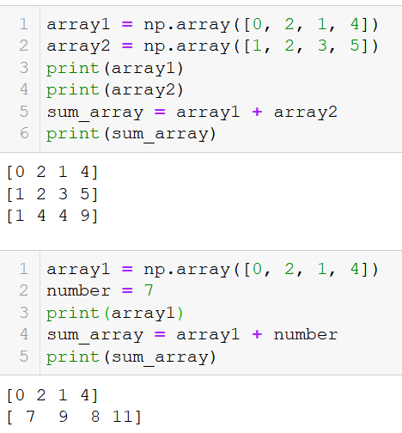
The + operator on arrays
The + operator on lists: On lists, the + operator will concatenate both lists into a new one.
The + operator on Numpy arrays – (vector sum): On Numpy arrays, however, the + operator will sum the elements of both Numpy arrays.
Broadcasting: If summed with a number instead, the elements in the Numpy array will each be incremented by the given value.

Slide 26
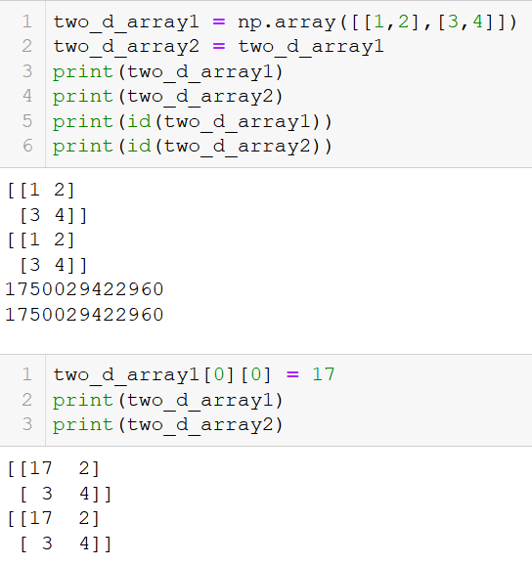
Aliasing, Shallow and Deep copies in arrays
As with lists, Numpy arrays are subject to the same issues about aliasing, shallow and deep copies.
If needed, use deep copies of the arrays.

Slide 27
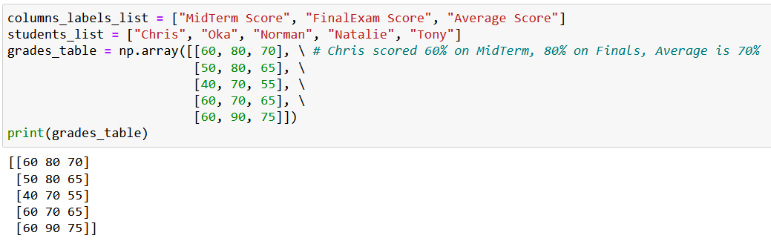
Activity 1 - Exam adjustments
Let us assume, that I have grades from my students listed in some Numpy array variable, as shown below.

Slide 28
Activity 1 - Exam adjustments
Let us assume, that I have grades from my students listed in some Numpy array variable.
The first line contains the column labels (student name, some scores) and the other lines will consist of entries regarding some of the students.
Let us assume that, as a professor, I have decided to be lenient towards my students.
I realized that the midterm was a bit too difficult compared to last year, and they failed more than expected… To compensate for that, I would like to increase the scores of all students on the midterm by 50%.
Will use a function to do so!

Slide 29
Activity 1 - Exam adjustments
Write a function grade_adjustment(),
which receives a grades table, grades_table,
increases the scores of all students on midterm by 50%,
re-calculates the average score, with the new adjusted midterm score,
and then returns a new updated grades table as its sole output.
Important note: The maximal score for the midterm exam is capped to 100. This means that a student which scores 80 points on the midterm, will not obtain 120 points after the adjustment, but only 100.

Slide 30
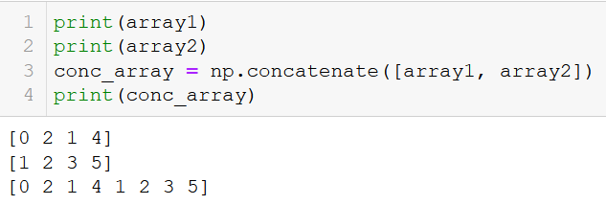
Concatenation on arrays
Since the + operator cannot be used for concatenation, Numpy comes with a concatenate() function.

Slide 31
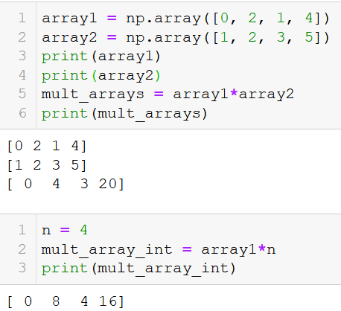
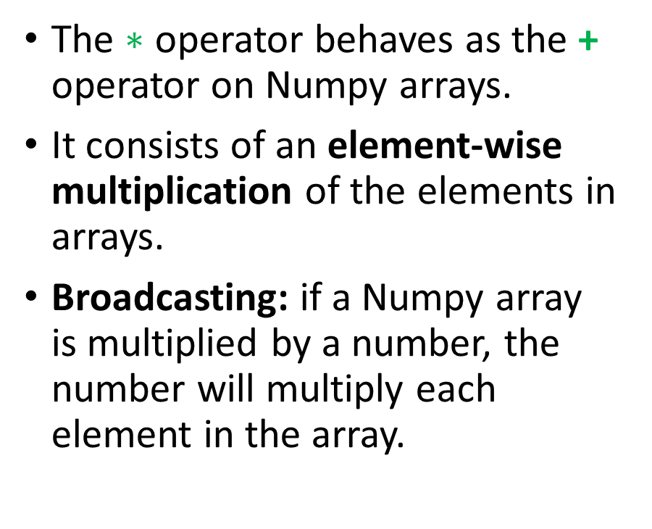
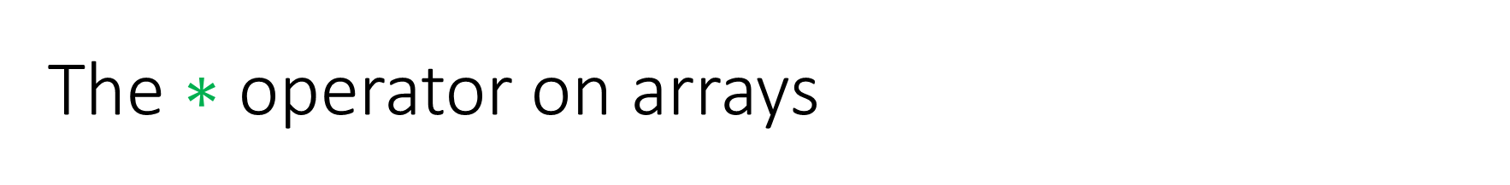
The $∗$ operator on arrays
The $∗$ operator behaves as the + operator on Numpy arrays.
It consists of an element-wise multiplication of the elements in arrays.
Broadcasting: if a Numpy array is multiplied by a number, the number will multiply each element in the array.

Slide 32
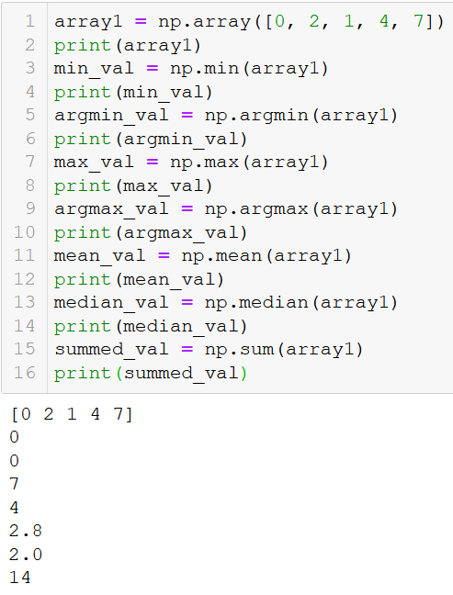
Additional functions
Additional Numpy functions
Min, max: returns the minimal, resp. maximal, values in array.
Argmin, argmax: returns the index where the minimal, resp. maximal, values are.
Mean, median: returns the mean, resp. median, value for a given array.
Sum: sums all the elements in the array together

Slide 33
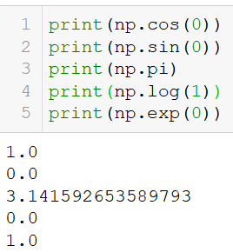
Mathematical functions and constants
Numpy also contains
Many mathematical functions (cosine, sine, logarithm, exponential, etc.)
And many mathematical constants (pi, etc.)

Slide 34
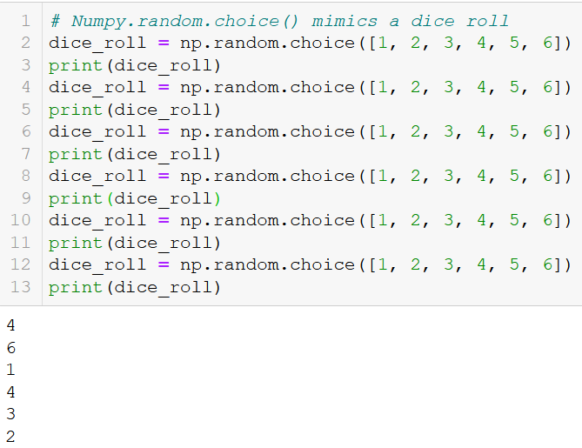
And so much more! RTFM!
Numpy has many more functions and tools to offer!
E.g., Random functions (to be covered in an upcoming session, if time allows?)
Learn more about Numpy (RTFM!) here:
https://numpy.org/doc/stable/

Slide 35
Conclusion (Chapter 12)
A quick word on memory management and lists: aliasing, shallow and deep copies.
What is a library?
What is the Numpy library and its basic concepts (e.g. arrays, math functions, etc.)?

Slide 36
Let us move on to our first Mini-project now!
Wait for me to explain and show you first.

